Slide 1
Leader Training
Notes:
Opening prayer
Have IGL Intro paper and popsicle stick for every participant.
Intros
Popsicle sticks

Slide 2
WHY ARE GROUPS IMPORTANT?
Groups help us to fulfill the Core Values of Grace Community Church:
Put God First
Champion Family
Build Community
Live a Life of Worship
Reach Beyond Our Walls
Notes:
Have IGL Intro paper and popsicle stick for every participant.

Slide 3
WHY ARE GROUPS IMPORTANT?
It is also important for partners to help lead groups because:
It supports our Vision through our Mission.
Vision: Our vision is to SHARE God's love by ELEVATING the community and to SEE lives changed.
Mission: Our mission is to CONNECT with those far from God, to FORM them into fully devoted followers of Christ, and ENGAGE them in mission to a needy world.
Notes:
Pick a popsicle stick to read Vision
Pick a popsicle stick to read Mission

Slide 4
DEFINE A WIN
What does a win look like in an IG this year?
Groups have 10% of participants that are first-time IG members
Each group having at least 12 people enrolled
75% of IG meeting in homes
40 Groups in 2024
50% of Groups to have childcare
90% attendance
Notes:
We have almost 70% of groups meeting in homes
We will have 41 groups this year
We have 38% with CC this semester (need 2 more)

Slide 5
GROUP PROMOTION
Filling The Groups:
Air Attack: Sunday host announcements, Social Media, and videos.
Ground Attack: Your personal invitation.
Sunday Mornings: IG Sign-ups on Sunday
Notes:
Know how to register
At table, until app is built

Slide 6
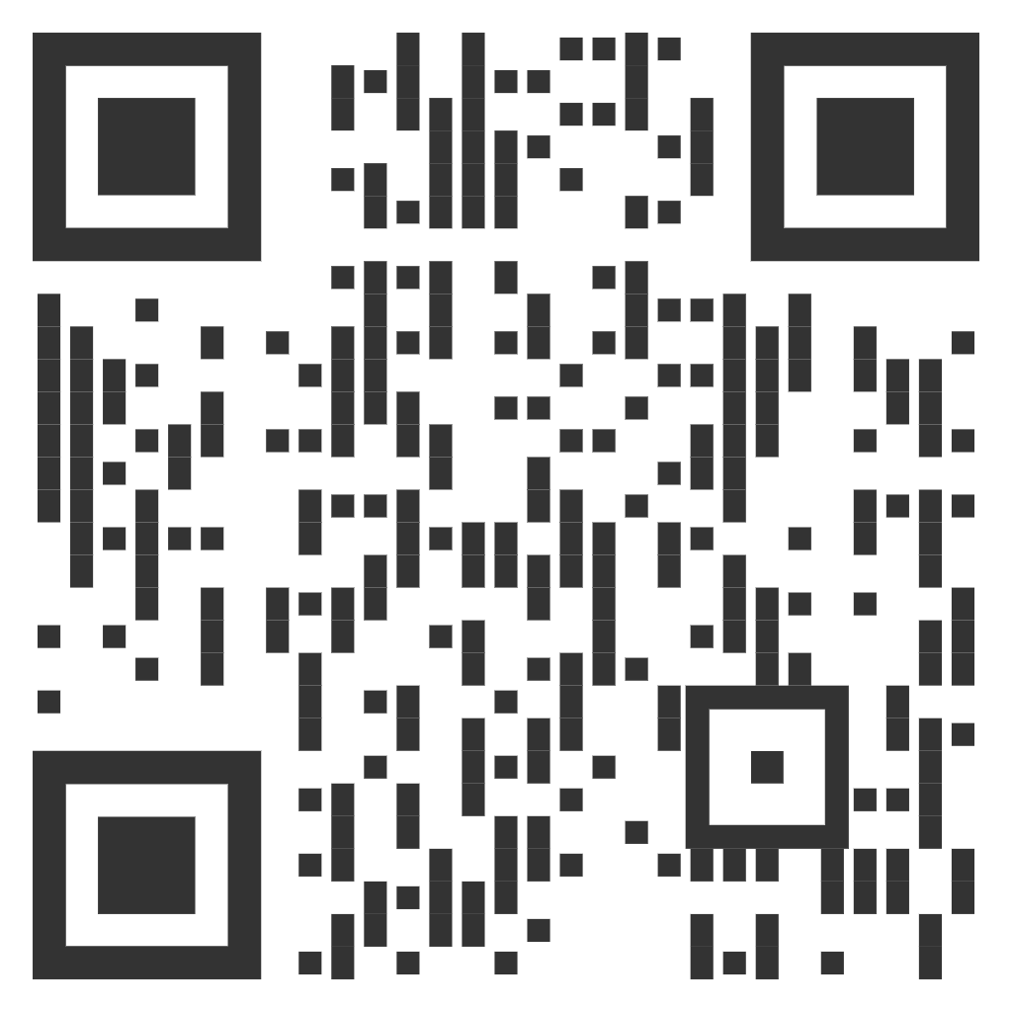
GROUP PROMOTION
Sunday Mornings: IGL Sign-up Help on Sunday

Slide 7
GROUP COMMUNICATION
Communication is critical to your group's health!
Early communication allows you to connect and engage with your group members.
Your communication puts new attendees at ease and gives them some expectations.
Communicate with your group through our new platform…
Communicate weekly started last week (4 weeks from sign-ups to 1st meeting)
Connect with everyone personally prior to the meeting. To ensure they will be attending. Two reasons: 1. Keep spots open. 2. Keep accurate attendance.
Email new members within 24 hours of their registration.
Welcome note (example on leader page)
Date, time, and location of first meeting
Notes:
Over communicate
Send out weekly emails
Reminder of meeting
Remind everyone to bring their book
Any additional info
Food needs, etc

Slide 8
GROUP COMMUNICATION
Communication is critical to our ministry’s health!
Communication with us.
Are members showing up?
Have you added anyone new?
Any childcare issues?
Respond to any request/questions from us.
Notes:
Over communicate
Send out weekly emails
Reminder of meeting
Remind everyone to bring their book
Any additional info
Food needs, etc

Slide 9
FACILITATING YOUR GROUP
Before the first meeting:
Pray for each person by name
Clean your house, put pets away
Have IG Member Intro Page ready (like we just did *optional)
Have popsicle sticks ready (if you are using them)
Create a roster for snack/food signups
Give out the schedule for the semester
(example on leader page)
Notes:
Lobby of GCC

Slide 10
FACILITATING YOUR GROUP
At the first meeting:
Hand out IG Member Intro Page ready (like we just did *optional)
Hand out popsicle sticks ready (optional, but highly recommended)
Jump into icebreaker
Fill out the roster for snack/food signups (at the end of group)
Take Attendance (at the end of group)
Notes:
Lobby of GCC

Slide 11
FACILITATING YOUR GROUP
Ongoing meetings:
Take Attendance
Weekly Communication via text or email (you can use or modify what I send weekly)
Be prepared.
Attend Service to know the content.
Review the Study questions before meeting
Recap Sunday Morning Announcements from the stage
Recap last session’s homework (if any)
Use popsicle sticks to engage members
Respect the clock
Silence is okay
Take Attendance
Notes:
Silence is ok
Don’t race through the discussion
It is ok to directly ask someone in the group a question
Ask open ended questions that promote discussion

Slide 12
FACILITATING YOUR GROUP
Think Friends, Not Intimacy
Foster Friendships
Friendships are part of our spiritual development.
It is awkward to get intimate too quickly with strangers in a foreign environment.

Slide 13
FACILITATING YOUR GROUP
Spaces of Spiritual Growth:
Public Space (church, mall, sporting event)
Social Space (break room, Impact Groups)
Personal Space (friends at a coffee shop/road trip)
Intimate Space (private dinners or romantic date)
We grow in all four spaces
We need relationships in all four spaces
No one space is more important that the other
We have a deficit of social space

Slide 14
FACILITATING YOUR GROUP
We are not called to be Biblical experts.
We need to facilitate conversation, not lead a lecture.
Rely on the curriculum.
Find an apprentice.
Think Apprentice, Not Expert:
Notes:
Silence is ok
Don’t race through the discussion
It is ok to directly ask someone in the group a question
Ask open ended questions that promote discussion

Slide 15
FACILITATING YOUR GROUP
Dealing with drama in your group:
See Handout for additional info
Use your discretion
Don’t let it derail the group
A separate conversation may need to happen later
Some situations might require pastor’s involvement
Notes:
Sometimes groups can get deep, that is a good thing
But sometimes it can lead to drama
If it’s not a serious issue, let them know they are loved and move on
If it is serious, let them know they are loved and move on
Then bring it to me
We want groups to be a safe place for everyone

Slide 16
FACILITATING YOUR GROUP
Let’s Practice
Facilitation Exercises
Notes:
2 exercises
1. make 10 observations about the passage.
Use popsicle sticks to ask for answers
2. Open-ended vs. close-ended questions
Uses popsicle sticks to ask for changes

Slide 17
FACILITATING YOUR GROUP
Make Observations
Closed-ended to Open-ended Questions
Addressing the derailing question
The Talker
Facilitation Exercises
Notes:
2 exercises
1. make 10 observations about the passage.
Use popsicle sticks to ask for answers
2. Open-ended vs. close-ended questions
Uses popsicle sticks to ask for changes

Slide 18
FACILITATING YOUR GROUP
Facilitation Exercise: 1 Timothy 2:1-7 ESV
First of all, then, I urge that supplications, prayers, intercessions, and thanksgivings be made for all people, 2 for kings and all who are in high positions, that we may lead a peaceful and quiet life, godly and dignified in every way. 3 This is good, and it is pleasing in the sight of God our Savior, 4 who desires all people to be saved and to come to the knowledge of the truth. 5 For there is one God, and there is one mediator between God and men, the man Christ Jesus, 6 who gave himself as a ransom for all, which is the testimony given at the proper time. 7 For this I was appointed a preacher and an apostle (I am telling the truth, I am not lying), a teacher of the Gentiles in faith and truth.
Notes:
2 exercises
1. make 10 observations about the passage.
Use popsicle sticks to ask for answers
2. Open-ended vs. close-ended questions
Uses popsicle sticks to ask for changes

Slide 19
FACILITATING YOUR GROUP
Facilitation Exercise: 10 Observations
1.
2.
3.
4.
5.
6.
7.
8.
9.
10.
Notes:
2 exercises
1. make 10 observations about the passage.
Use popsicle sticks to ask for answers
2. Open-ended vs. close-ended questions
Uses popsicle sticks to ask for changes

Slide 20
FACILITATING YOUR GROUP
Facilitation Exercise: Closed-ended to open-ended
Does 1 Timothy 2:1 instruct believers to pray for all people?
Notes:
2 exercises
1. make 10 observations about the passage.
Use popsicle sticks to ask for answers
2. Open-ended vs. close-ended questions
Uses popsicle sticks to ask for changes

Slide 21
FACILITATING YOUR GROUP
Facilitation Exercise: Closed-ended to open-ended
How would you interpret Paul’s words in verse 1 to pray for all people, and what implications does it have for relationships with others during this election year?
Notes:
2 exercises
1. make 10 observations about the passage.
Use popsicle sticks to ask for answers
2. Open-ended vs. close-ended questions
Uses popsicle sticks to ask for changes

Slide 22
FACILITATING YOUR GROUP
Facilitation Exercise: Curbing derailing conversation
“So, who do you think is going to win the election?”
“Did you see the latest news about Trump/Harris/Vance/Walz?”
Notes:
2 exercises
1. make 10 observations about the passage.
Use popsicle sticks to ask for answers
2. Open-ended vs. close-ended questions
Uses popsicle sticks to ask for changes

Slide 23
FACILITATING YOUR GROUP
Facilitation Exercise: The Talker
Walking into this restaurant, you’re greeted with a setting that feels both familiar and comfortably generic. The space is designed with a sort of cookie-cutter charm that’s become the hallmark of many chain and mid-tier dining establishments. The floors are a polished wood or laminate, likely chosen for durability and ease of cleaning rather than aesthetics. Tables are arranged in a grid-like fashion, maximizing seating capacity without much thought to creating an intimate atmosphere. Each table is adorned with a simple, square tablecloth and a few basic condiments—salt, pepper, and a standard bottle of ketchup. The chairs are functional, if not particularly stylish, with their padded seats offering just enough comfort for a meal but not enough to linger long after dessert.
The walls are adorned with artwork that’s as unremarkable as it is uninspired. The paintings or prints are often mass-produced, featuring generic landscapes or abstract designs that do little to contribute to the ambiance. The lighting is uniformly bright, set to a level that avoids creating any shadows but also eliminates any sense of warmth or coziness. It’s clear that the goal here is functionality over flair, aiming to cater to a broad demographic rather than creating a memorable experience.
As you settle in, you’re handed a menu that, while extensive, is composed of items that you’ve seen countless times before. The appetizers include the usual suspects: mozzarella sticks, calamari, and a spinach artichoke dip. Each of these options is presented with the same predictable garnishes and dipping sauces, prepared with a standard approach that ensures they meet expectations but rarely exceed them. The main courses offer a similar level of predictability, featuring a selection of burgers, sandwiches, salads, and pastas. The burger choices range from classic cheeseburgers to a few specialty options, each presented with the same fresh bun and standard accompaniments. The pasta dishes are comforting but conventional, with a variety of sauces that are familiar to anyone who has dined at a similar establishment before.
The drink menu is equally conventional, featuring a range of soft drinks, iced teas, and basic alcoholic options. There’s nothing particularly unique or adventurous here; rather, it’s a selection that aims to please the average diner without pushing any boundaries. The cocktail list includes a few well-known classics like margaritas and mojitos, and while they’re likely to be well-made, they won’t offer any surprising twists or creative interpretations.
When it comes time to order, the service staff is friendly and efficient, though there’s a certain mechanical quality to their interactions. They follow a script that ensures all bases are covered but lacks any real personal touch. They’re prompt in taking your order, and if you need anything during your meal, they’ll address your requests quickly. However, you might find yourself longing for a bit more engagement or warmth from the people serving you. The staff does their job well, but they seem to be operating from a playbook rather than adding any personal flair to their service.
The food arrives in a timely manner, and it’s clear that there’s an effort to present each dish in an appealing way, but the results are predictably straightforward. The burger, for example, is cooked to your requested level of doneness, and it’s accompanied by a side of crispy fries that are seasoned just enough to be enjoyable without standing out. The pasta is served with a generous portion of sauce and a sprinkling of parmesan cheese, and while it’s satisfying and flavorful, it lacks the kind of inventive touches that might elevate it beyond the ordinary.
Dessert options follow the same pattern of predictability. You’ll find a selection of classics like chocolate cake, cheesecake, and apple pie. These desserts are presented with care, but they adhere to tried-and-true recipes rather than offering any new or exciting variations. The chocolate cake is rich and moist, and the cheesecake is creamy, but neither dessert is likely to leave a lasting impression. They’re exactly what you’d expect from a place like this: comforting and familiar, but not particularly memorable.
As you finish your meal and prepare to leave, you’re left with the sense that the restaurant has fulfilled its role admirably, if not spectacularly. It’s a place that delivers on its promises of providing a reliable dining experience without straying too far from the middle of the road. There are no dramatic highs or lows; it’s a consistent, steady option for a meal out.
In summary, this restaurant offers a dependable, if unremarkable, dining experience. It caters to a broad audience with a menu full of familiar choices and an environment designed for maximum comfort and minimal risk. There’s nothing particularly groundbreaking about the food, the service, or the atmosphere, but there’s a certain value in that predictability. If you’re looking for a place where you know exactly what to expect and where the meal is solid but not exceptional, this restaurant fits the bill perfectly. It’s a reliable choice for a routine meal out, though it may not offer the excitement or innovation that some diners seek.
Notes:
2 exercises
1. make 10 observations about the passage.
Use popsicle sticks to ask for answers
2. Open-ended vs. close-ended questions
Uses popsicle sticks to ask for changes

Slide 24
FACILITATING YOUR GROUP
Dealing with drama in your group:
See Handout for additional info
Use your discretion
Don’t let it derail the group
A separate conversation may need to happen later
Some situations might require pastor’s involvement
Notes:
During this election year and during an election, we can get off-topic quickly.

Slide 25
FACILITATING YOUR GROUP
Service project:
We require each group to do a service project each semester.
Talk to your groups and send me and Lisa a date and a plan for your project by November 3rd.
Ideas: Police/Fire department (lunch/special projects), Local schools (lunch/campus clean-up), Our ministry partners (RCAP, HHH, etc.)
Notes:
Remember to communicate with us

Slide 26
FACILITATING YOUR GROUP
Communion:
We ask each group to observe communion together each semester
Please let me know if you need/want any help.
We will have a date for all groups to take communion. TBD…
Notes:
Let me know when you plan to do it, before the start of your group.
I will do my best to visit every group I can, I can visit during communion if you need the help.

Slide 27
FACILITATING YOUR GROUP
Child Care:
Children's Ministry Director
Amy Sickel
Email: amy@discovergrace.church

Slide 28
FACILITATING YOUR GROUP
Be a leader of leaders:
You do not have to do everything yourself
Keep an eye out for potential leaders
Pray for your group
Notes:
You do not have to do everything yourself
Recruit people to help with food
Or to help with other aspects of your meetings
Keep an eye out for future potential leaders
Encourage them to talk to me about leading a group next semester
They must have been here a year
Pray for your group
If you wont, who will
If you are not able to facilitate this meeting it is a good opportunity to encourage a member of your group to step up and lead one week in your absence.
It might also help give them the push they need to being a leader in the future.
So pick someone out week one or two and encourage them to fill in,

Slide 29
FACILITATING YOUR GROUP
Important links:
My.discovergrace.church
Discovergrace.church/ig
Discovergrace.church/iglead
Notes:
Take attendance
Email your group

Slide 30
FACILITATING YOUR GROUP
Attendance:

Slide 31
PLANNING CENTER
Here is what we do know:
We are switching databases, one of which integrates with our website. (Refresh coming soon)
We will have an app
Communication available in the app
Attendance in the app
Old data will not be on the new system but will still be available when needed.
Easy to use
You can take notes in the app on Sunday morning
Group Study material will be on the app.
Some handouts will be available.
Notes:
Take attendance
Email your group

Slide 32
FACILITATING YOUR GROUP
Important dates: SAVE THE DATES
IG Signups start on September 8th
Groups start the week of October 6th
Groups end by November 30th
IG/Volunteer Celebration Dinner is Saturday, December 7th, at 6:00 pm at Grace CC.

Slide 33
Impact Group Leader Meeting
Important reminders:
Make contact as soon as you can
Make contact often before you start
Send welcome note
Tell them when the first meeting is
Tell them any location details
Track your attendance through rock
Let me know how I can help.

Slide 34
FACILITATING YOUR GROUP
Questions?

Slide 35
Impact Group Leader Meeting
James Hess
Email: james@dicovergrace.church
Cell: 936-232-0315

Slide 36
Leader Training
Notes:
Opening prayer

