Slide 1


Leader Training
Notes:
Opening prayer

Slide 2


WHY ARE GROUPS IMPORTANT?
Groups help us to fulfill the Core Values of Grace Community Church:
Put God First
Champion Family
Build Community
Live a Life of Worship
Reach Beyond Our Walls

Slide 3
WHY ARE GROUPS IMPORTANT?
It is also important for partners to help lead groups because:
It supports our Vision though our Mission.
Vision: Our vision is to SHARE God's love by ELEVATING community; to SEE lives changed.
Mission: Our mission is to CONNECT with those far from God, to FORM them into fully devoted followers of Christ, and ENGAGE them in mission to a needy world.

Slide 4
DEFINE A WIN
What does a win look like in an IG this year?
Groups have 10% of participants that are first time IG members
Each group having at least 12 people enrolled
75% of IG meeting in homes
40 Groups in 2024

Slide 5
GROUP PROMOTION
Filling The Groups:
Air Attack: Sunday host announcements, Social Media, and videos.
Ground Attack: Your personal invitation.
Know about all groups
- Fill every group, not just yours
Notes:
Know how to register
Online
Kiosk

Slide 6
GROUP COMMUNICATION
Communication is critical to your group's health!
Early communicate allows you to connect and engage with your group members.
Your communication puts new attenders at ease and gives them some type of expectation.
Communicate with your group through https://my.discovergrace.church
Email new members within 24hrs of their registration.
  Welcome note (example on leader page)
  Date, time, and location of first meeting
Notes:
Over communicate
Send out weekly emails
Reminder of meeting
Remind everyone to bring their book
Any additional info
Food needs, etc

Slide 7
FACILITATING YOUR GROUP
For the first meeting:
    Pray for each person by name
    Clean your house, put pets away
    Jump into study
      You can do an icebreaker if you would like
    Have a couple of extra books just incase
    Create roster for snack/food signups
    Give out schedule for the semester (example on leader page)
Notes:
Lobby of GCC

Slide 8
FACILITATING YOUR GROUP
Ongoing meetings:
    Take Attendance
    Weekly Communication via text or email
    Be prepared for the current weeks lesson
    Recap Sunday's Announcements
    Recap last sessions homework (if any)
    Respect the clock
    Silence is okay
    Take Attendance
Notes:
Silence is ok
Don’t race through the discussion
It is ok to directly ask someone in the group a question
Ask open ended questions that promote discussion

Slide 9
FACILITATING YOUR GROUP
Think Friends, Not Intimacy
    Foster Friendships
    Friendships are part of our spiritual development.
    It is awkward to get intimate too quickly with strangers in a foreign environment.
Notes:
Silence is ok
Don’t race through the discussion
It is ok to directly ask someone in the group a question
Ask open ended questions that promote discussion

Slide 10
FACILITATING YOUR GROUP
Spaces of Spiritual Growth:
    1.Public Space
    2. Social Space
    3. Personal Space
    4. Intimate Space
    We grow in all four spaces
    We need relationships in all four spaces
    No one space is more important that the other
    We have a deficit of social space
Notes:
Silence is ok
Don’t race through the discussion
It is ok to directly ask someone in the group a question
Ask open ended questions that promote discussion

Slide 11
FACILITATING YOUR GROUP
Think Apprentice, Not Expert:
    We are not called to be Biblical experts.
    We need to facilitate conversation, not lead a lecture.
    Rely on the curriculum.
    Find an apprentice.
Notes:
Silence is ok
Don’t race through the discussion
It is ok to directly ask someone in the group a question
Ask open ended questions that promote discussion

Slide 12
FACILITATING YOUR GROUP
Service project:
  We require each group to do a service project each semester.
    The All-Church Clean-up Day will not be a service project opportunity.
  Talk to your groups and have a date and a plan for your project to me by March 9th.
  Reach out to me if you need some help with ideas.

Slide 13
FACILITATING YOUR GROUP
Communion:
      We ask each group to observe communion together each semester
        The week of March 24th is Holy week and would be a good time for communion.
        Please let me know if you need any help.
      You as the leader can choose when that will work best for your group
Notes:
Look at your lesson, and see if it fits naturally in one lesson
You can also make one meeting all about that
Don’t try to squeeze it in, make it important
If you need help finding a place to make it fit, let me know
Let me know when you plan to do it, before the start of your group.

Slide 14
FACILITATING YOUR GROUP
Child Care:
Children's Ministry Director
Amy Sickel
Email: amy@discovergrace.church
Notes:
If you are not able to facilitate this meeting it is a good opportunity to encourage a member of your group to step up and lead one week in your absence.
It might also help give them the push they need to being a leader in the future.
So pick someone out week one or two and encourage them to fill in,

Slide 15
FACILITATING YOUR GROUP
Be a leader of leaders:
      You do not have to do everything yourself
      Keep an eye out for potential leaders
      Pray for your group
Notes:
You do not have to do everything yourself
Recruit people to help with food
Or to help with other aspects of your meetings
Keep an eye out for future potential leaders
Encourage them to talk to me about leading a group next semester
They must have been here a year
Pray for your group
If you wont, who will

Slide 16
FACILITATING YOUR GROUP
ZOOM credentials:
      User: ig@discovergrace.church
      Password: Grace1234
Notes:
You can offer a zoom option for your group if:
Someone gets covid
If someone can’t be there but still wants to join
Its not necessary, but available

Slide 17
FACILITATING YOUR GROUP
Important links:
      My.discovergrace.church
      Discovergrace.church/ig
      Discovergrace.church/iglead
Notes:
Take attendance
Email your group

Slide 18
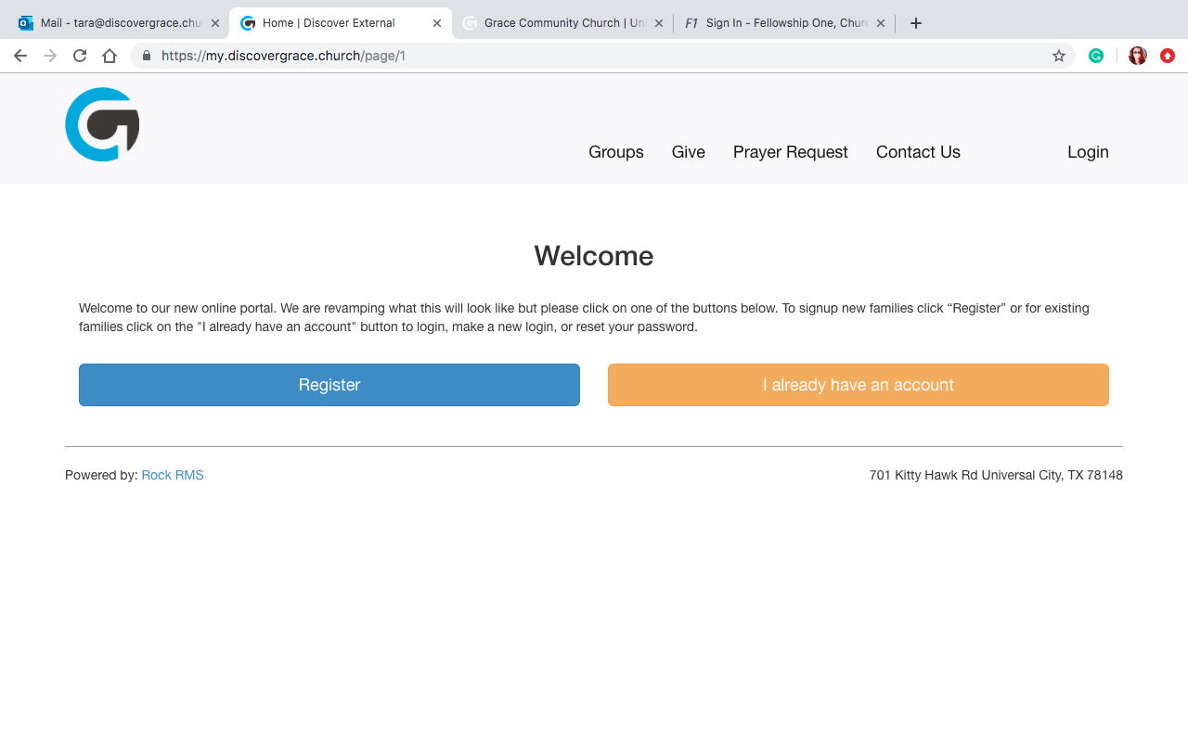
FACILITATING YOUR GROUP
How to use Rock: my.discovergrace.church

Slide 19
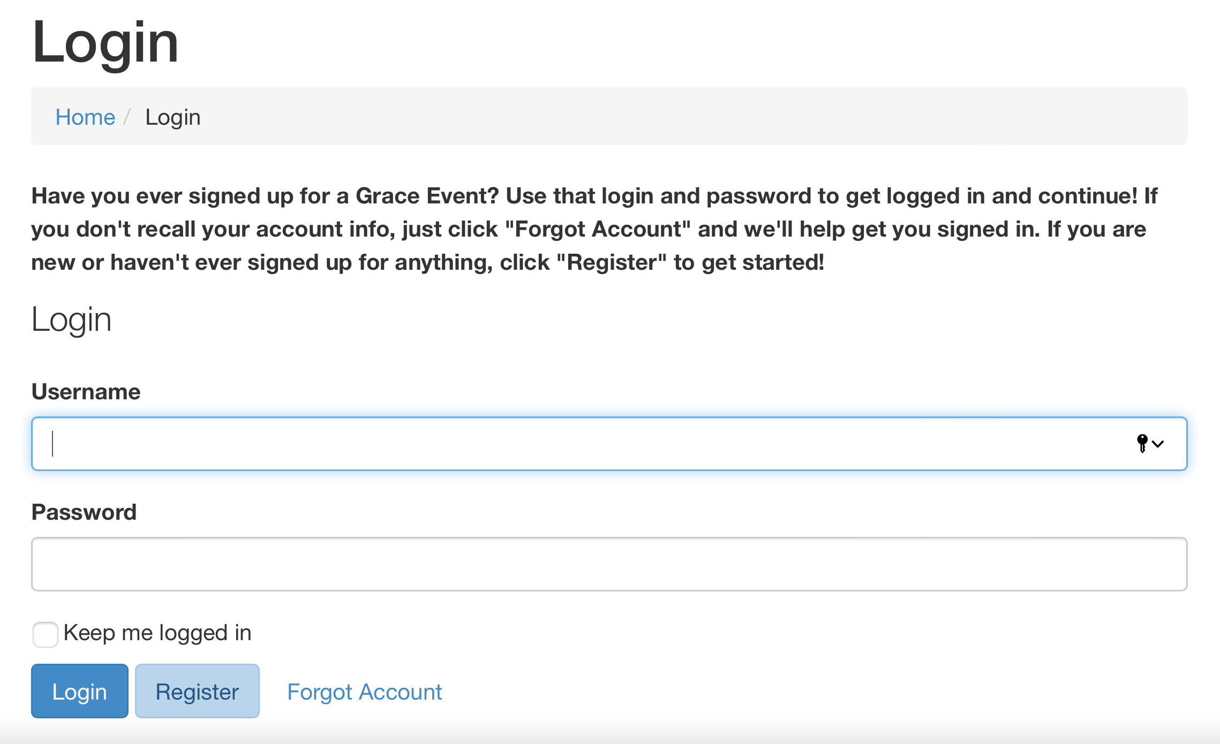

Slide 20
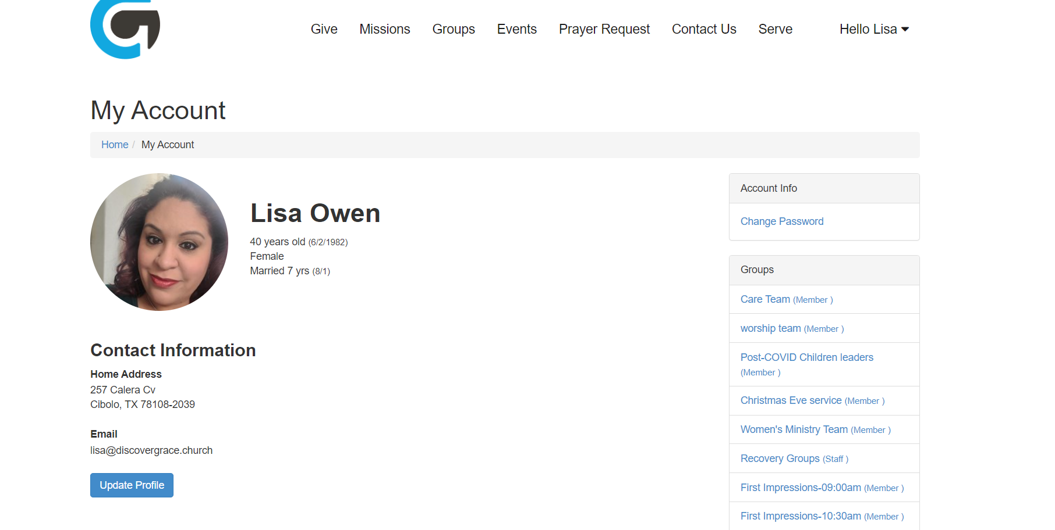
FACILITATING YOUR GROUP
How to use Rock: my.discovergrace.church

Slide 21
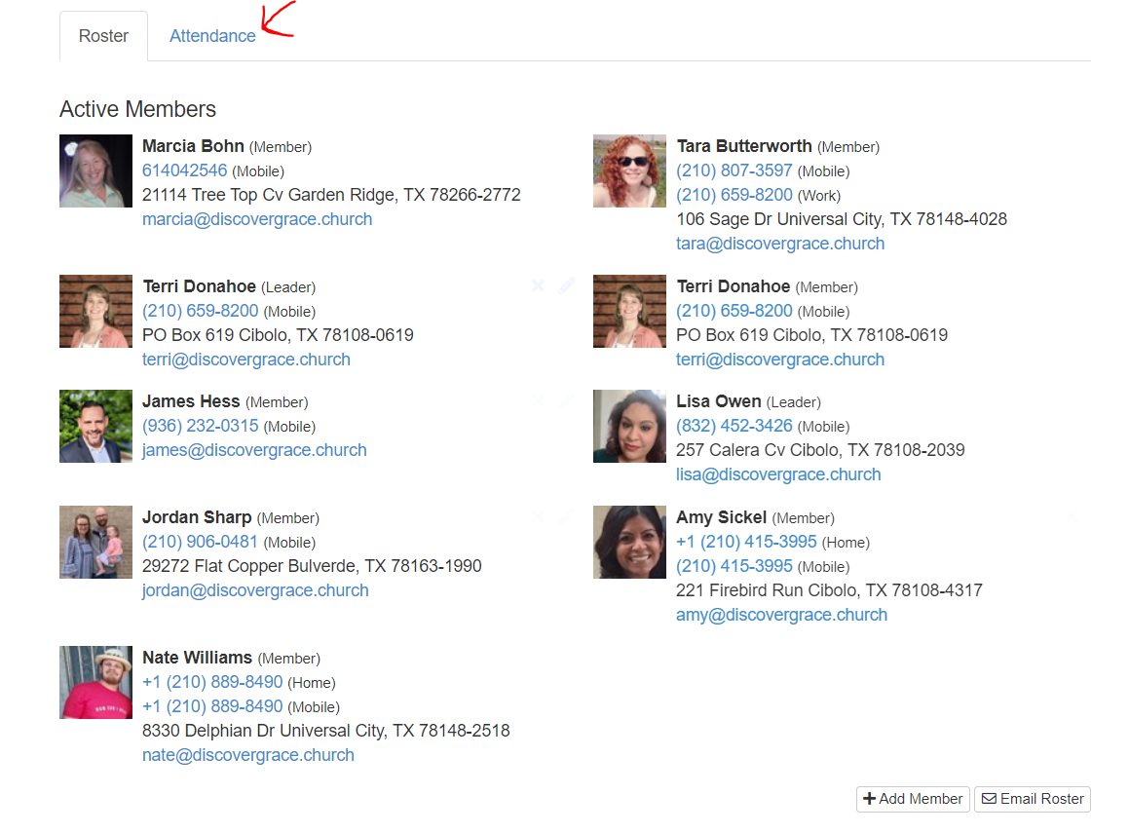

Slide 22
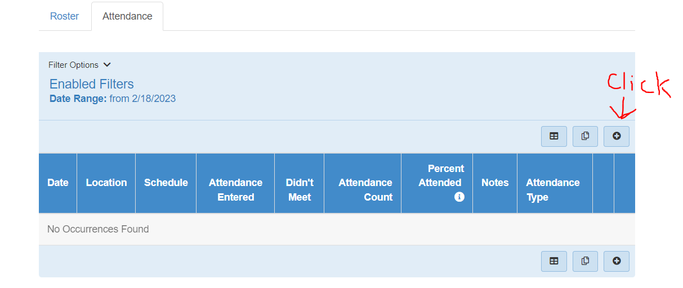

Slide 23
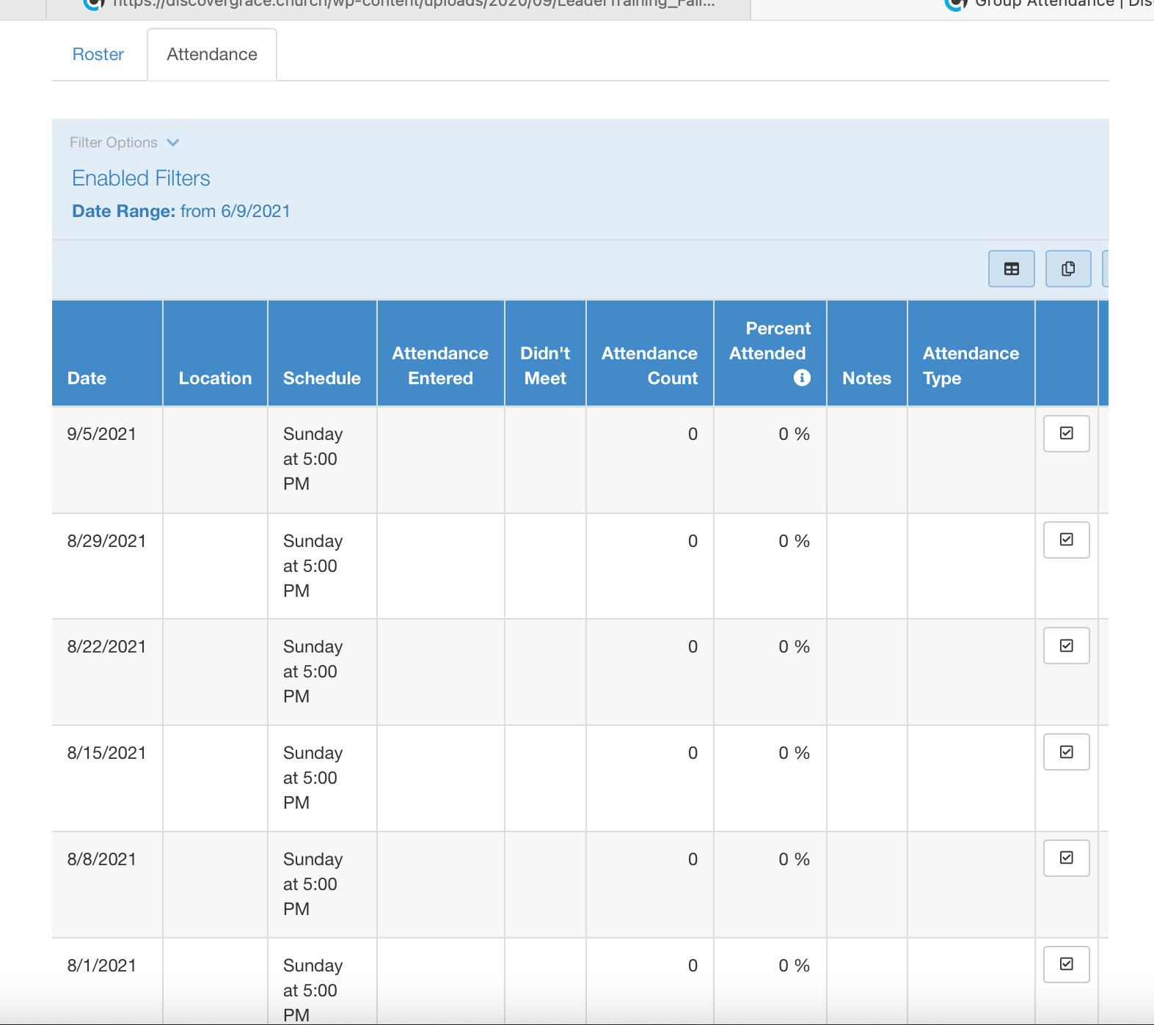
FACILITATING YOUR GROUP
How to use Rock: my.discovergrace.church

Slide 24
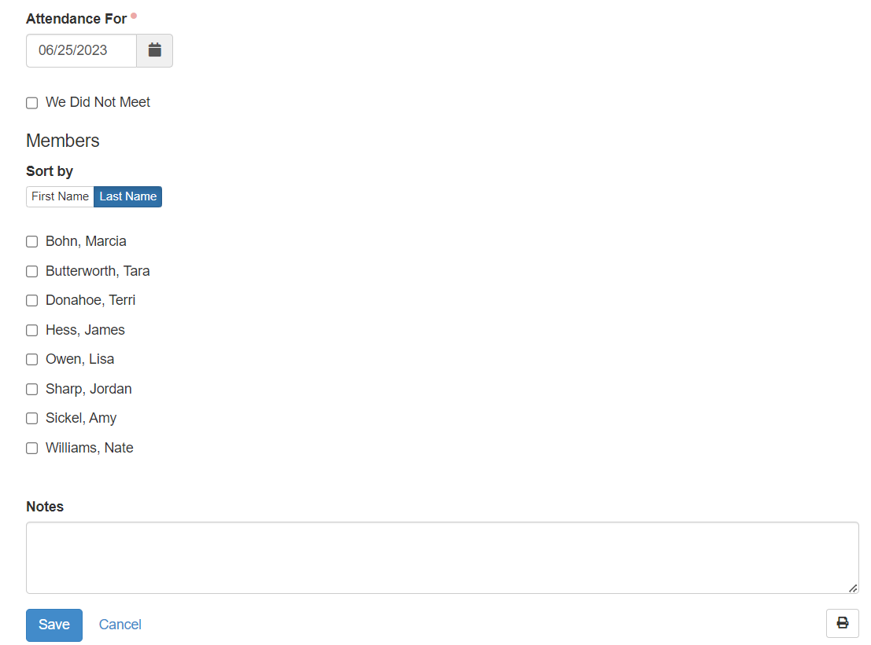
FACILITATING YOUR GROUP

Slide 25
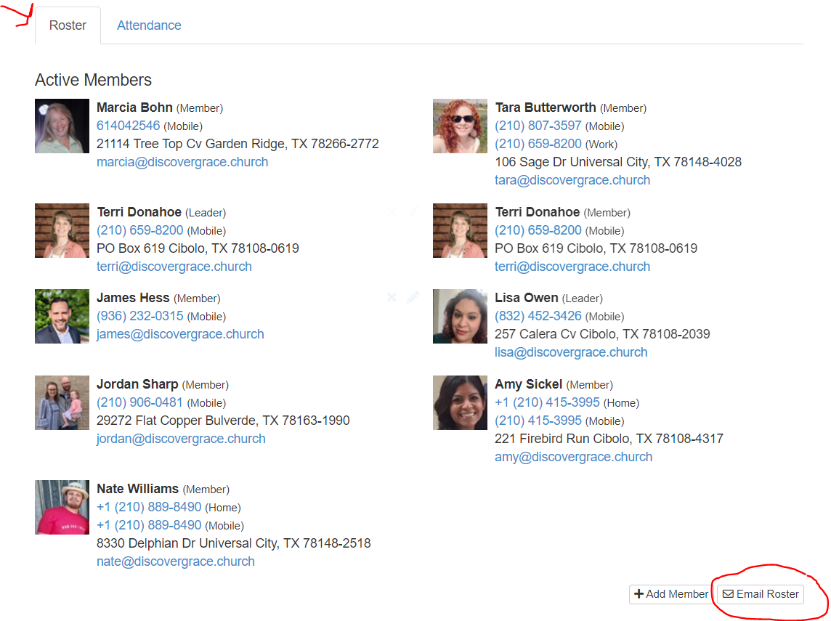

Slide 26
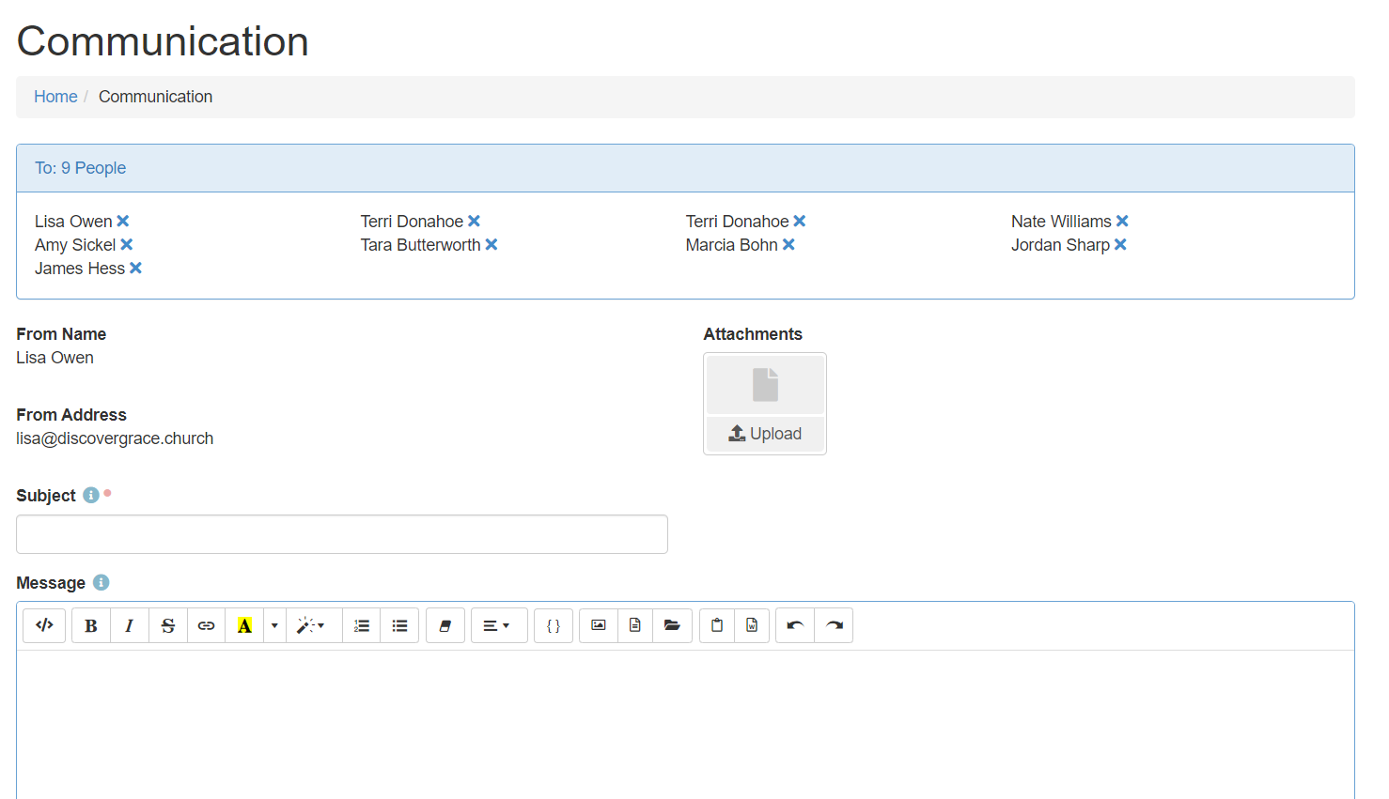

Slide 27
FACILITATING YOUR GROUP
Dealing with drama in your group:
      See Handout for additional info
      Use your discretion
      Don’t let it derail the group
      A separate conversation may need to happen later
      Some situations might require pastor involvement
Notes:
Sometimes groups can get deep, that is a good thing
But sometimes it can lead to drama
If it’s not a serious issue, let them know they are loved and move on
If it is serious, let them know they are loved and move on
Then bring it to me
We want groups to be a safe place for everyone

Slide 28
FACILITATING YOUR GROUP
Important dates: SAVE THE DATES
      IG Signups begin January 14th
      Groups start the week of February 11th
      Groups end by April 20th (Some my end sooner)
      IG Celebration Dinner is Friday, April 19th, 6:00pm at
      Grace Community Church

Slide 29
FACILITATING YOUR GROUP
Questions?

Slide 30
Impact Group Leader Meeting
Important reminders:
Be familiar with all the groups
Make contact as soon as you can
Send welcome note
Tell them when the first meeting is
Tell them any location details
Track your attendance through rock
Let me know how I can help.

Slide 31
Impact Group Leader Meeting
James Hess
Email: james@dicovergrace.church
Cell: 936-232-0315

Slide 32
Leader Training
Notes:
Opening prayer

